Slide 1

EXL Solution for E Commerce Print to web Reprographics
March 17th, 2022

Slide 2


Agenda
Executive Summary
FTE’s View
Solution Cornerstones
Operating Model
Location Strategy
Recruitment & Hiring
Quality Framework
Transitions & Knowledge Management
Transformation
Commercials
Annexure

Slide 3









We understand your strategic objectives and are bringing together a holistic solution…
Executive Summary
Strategic Objective: Build a cost effective, simplified and efficient operation to maximize customer and business value
Next priorities
Reduce operating costs
No disruption to people & operations
Maximize customer and business value
Customer focused transformation
Supplier
Ownership
EXL’s enablers
Experienced implementation team from Phase 1
Digital / Workflow enabled operations
Tech-led transformation
Committed efficiency benefits & SLA ownership
Drive frictionless experience for next while reducing operating costs and implementing technology led transformation

Slide 4
Solution Overview
Centralised operations driving SLA’s and performance mgmt
Excellence in Service delivery
Dedicated Program Management team for seamless transition
Pre-identified transformation initiatives to drive efficiency
Service Delivery
Transition
Transformation
In scope work to be serviced from Pune, India
Ownership of SLAs from day 1
Enhanced workflow solution to reduce manual effort and accurate reporting
2-way channel for effective and transparent communication
Quality Assurance model that focuses on outcomes along with compliance to process
Embedded analytics for continuous improvements and intelligent operations
Dedicated & experienced implementation team from phase 1
EXL plan to hire 100% Incumbent with minimum success rate of 80%
Clear cut over plan built showcasing ramp up at EXL and ramp down at Incumbent
Teams aligned for all critical path items like IT, infra, recruitment and implementation
HR Helpdesk for smooth onboarding of Incumbent hires
Best practices from Phase 1 – EXL to do most of the heavy lifting
30%+ FTE reduction between Y1 to Y3 of engagement through EXL Vue.AI suite
NEXT dedicated Digital CoE
Workflow & Reporting Solution for Print to Web process
AI led Product Attribution/Tagging for automated assessment of product photos
Granular tagging, labeling and classification
AI led Automated image moderation for automatic assessment & Error detection as per Image guidelines
Estimated benefits. Assumptions to be validated in the next phase

Slide 5








Brilliant @ The Basics
BRILLIANT @ THE BASICS
BRILLIANT @ THE BASICS
1
Aligned company culture and people strategy
Close alignment with Next culture and values
Next-based HR
Data-driven hiring
2
Do right by the customer
Ownership of processes and SLAs; drive performance
Proactive and timely communication; ask for help
Controls and embedded analytics; enhance outcomes
Open communication
Employee wellbeing
Diversity, inclusion and CSR
BRILLIANT @ THE BASICS
BRILLIANT @ THE BASICS
4
Robust Reporting, staffing and scheduling
3
Performance management driving great CX
MIA and Power BI dashboards
Intelligent performance management
DigitalAssurance Quality
Flexible, scalable operation model
Six-Pillars-aligned metrics
BRILLIANT @ THE BASICS
“We were all taken aback with the interruption due to COVID19 but were heartened to see the collective and collaborative effort between EXL and our teams. EXL’s response was rapid and effective with from no home working to 1000+ resources working from home within few weeks. EXL’s out of the box thinking with analytical (MIA) and RPA solutions ensured we keep serving our customers during this difficult time. This has been a true testament of our collaborative approach and strategic partnership.”
CLIENT TESTIMONIAL
5
Empowered colleagues with digital solutions
AI COACH
MIA
AIM platform
Infinity

Slide 6
FTE requirement and rationale
Headcount type
Current Headcount
To Be Headcount
EXL Headcount (Associate)
EXL Headcount (Associate)
Remarks
Associates
163
145
14
12
EXL staffing is based on increased weekly productive time:
We commit to deliver 40 hrs / associate / week of which 36.5 will be productive and 3.75 for team huddles, subject to approval from Next
Shrinkage and leaves will be managed through roster (additional headcount over and above billable headcount)
Sr. Manager -Operations
1
1
-
-
Sr. Manager - Training
1
1
-
-
Manager - Operations
8
7
2
2
 | Shift | Break | Production | Huddle
Current | 8 | 1 | 6.25 | 0.75
To Be | 8 | 0^ | 7.25 | 0.75
Manager - Integration
1
1
-
-
Team Manager – Process Leader
7
6
7
6
^EXL contracted hours our 9 hrs / daily of which 1 hour is break
Process Trainer
1
1
-
-
Test Engineer
2
2
-
-
Total
184
166
23
20
Print to Web
Reprographics

Slide 7
Proposed Org Structure
Rahul Arora
Engagement Leader
Steering Group
Prashant Chibber
Service Delivery Head
Shubham Bhardwaj
Transition Lead
Akshi Saxena
Head of Operations - Next
Ujwala Ganorkar
HR Partner
Execution Team
To be updated
Akansha Sehgal
Transition Manager
Piyush Aggarwal
Transformation Lead
Preeti Chopra
HR Leader
Mompia Saha
BCP SME
Aakash Gupta
Analytics Leader
Kaushal Aggarwal
Digital Leader
Kumar Ravi
Information & Cyber Security Leader
Mukul Varma
WFM Leader
Ajay Gutta
Technology Lead
Dedicated Resources
Shared Resources
7

Slide 8
Operating Model
Robust recruitment engine – hire at short notices
Temporary resources for seasonal spikes
Utillise resources freeing up from Next transformation for new work
Move relevant resources within EXL to Next (if available)
RESOURCING
Change note before starting any new work
Transparent commercials – no surprises
COMMERCIALS
Same rigor as in the original scope of work
Next specific Transition & Technology playbook for faster and smoother implementations
Robust governance to ensure no-surprises
IMPLEMENTATION
8

Slide 9
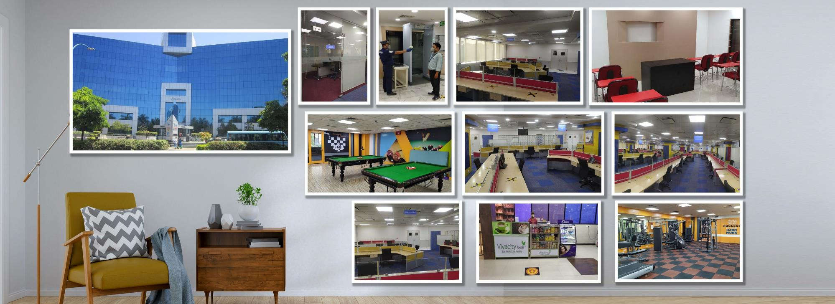
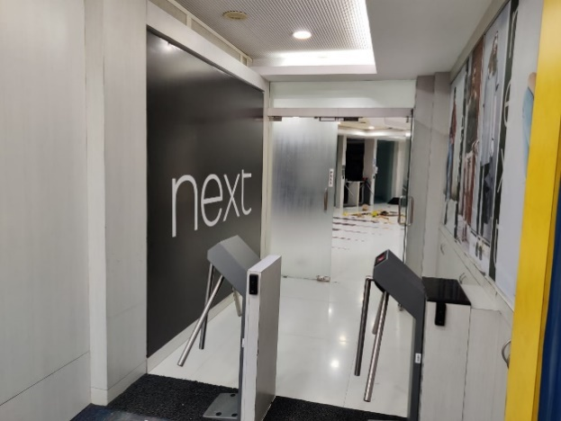
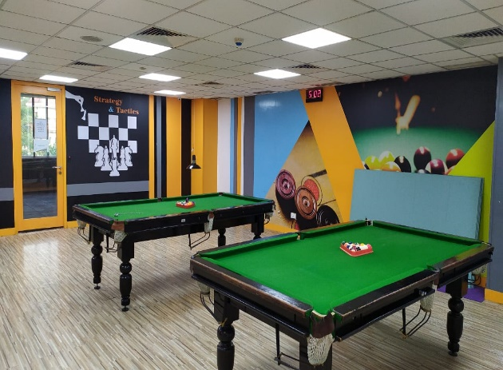
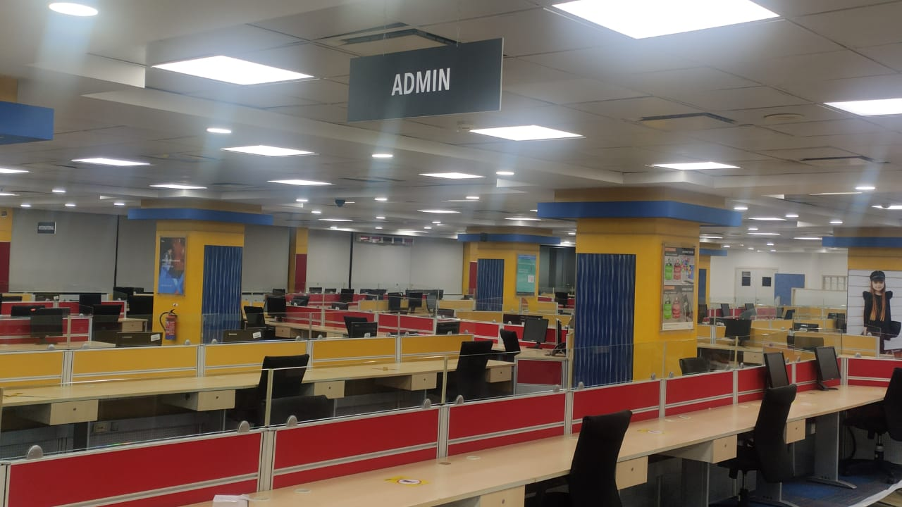
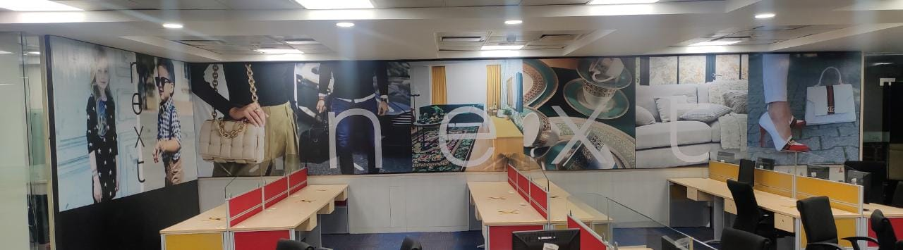
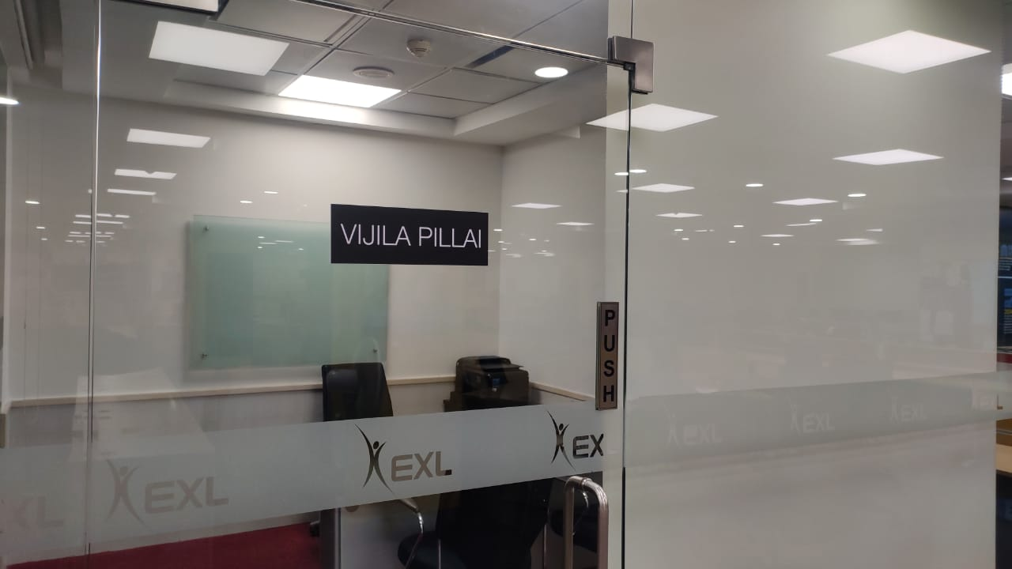
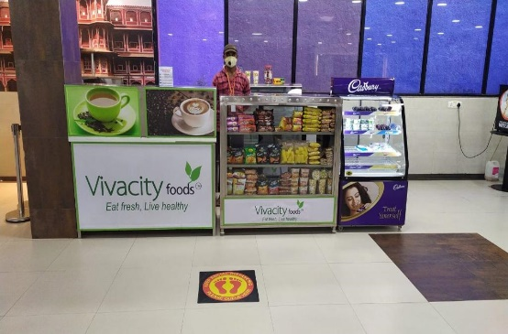
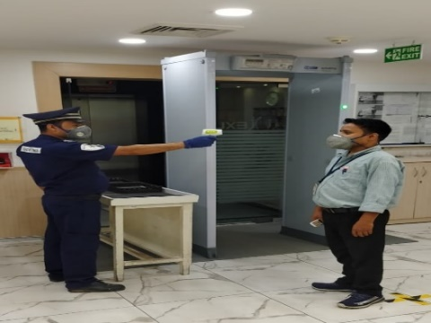
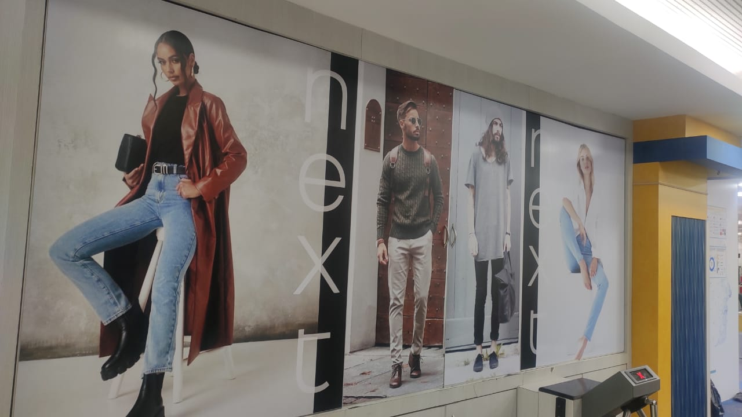
Location Strategy
Next Operations
Third floor, Tower 12, Magarpatta
Five minute walk from existing Next operations
Scalable & state-of-the-infrastructure for future growth
COVID19
safeguards in place
9

Slide 10
Recruitment & Hiring Approach
RESOURCE MIX
70% to 80% incumbent staff
(top 3 quartile) rebadged to retain Next’s knowledge and ensure continuity
10-20% ex-Next staff
who have left Capita to bring relevant Next experience
10-20% fresh talent
staffed to bring fresh perspective and act as a catalyst to change
RECRUITMENT ENGINE
EMPLOYEE VALUE PROPOSITION
MITIGATING RISKS
40+ recruiters ready to support Next hiring: 35+ tie-ups with specialised recruitment agencies
Market mapping & headhunting already activated; prioritisation of manager, SMEs along with high-performers
Special employee referral programmes; Social Media campaigns/ LinkedIn in-mails customised & ready for launch
Over 90% success rate with incumbent employees; successfully executed multiple engagements - 6,000+ employees
16+ years presence in Pune market; respected brand in Pune
Compensation for rebadged employees is at par or better, with retention bonus
Continuity of service with Next along with no additional travel effort (Distance 5 minutes from existing Incumbent location)
EXL Learning Academies help build better careers; digital learning platform
2 months notice period (Timelines factored in our plan)
Delay in BGC checks (with approval from Next)
ID deletion / creation (Support required from Next)
Identifying top performers (Support required from Next)
10

Slide 11








Transition Solution
Location EXL Pune(5 mins from existing incumbent office) Enable hybrid model of Work from home(WFH) and work from office(WFO) | Timeline Transition from incumbent to EXL planned during the lean period Timelines and duration built basis learnings/ best practices from phase 1 | Incumbent Hiring EXL has assumed staff conversion rate of minimum 80% from the incumbent Early onboarding of key incumbent leadership team/trainer External Staff to be hired based on pre-approved Job Description Planned buffer on assumed conversion rate
Incumbent Cut Over Clear cut over plan built showcasing ramp up at EXL and ramp down at incumbent No disruption to operations | Statement of Work Statement of work to be built accurately depicting scope, effort and committed service level performance and improvement roadmap | Transition Readiness EXL is prepared on all critical path items IT Infra and technology Recruitment Office Location Implementation Team
Our People Alignment of culture with people strategy for engaged employees & delivering superior customer service | Performance Management EXL will define success criteria for the implementation and report on the same Committed service levels to be regularly reported and discussed | Transformation Roadmap Dedicated team working with next to deliver on the committed transformation agenda
Robust Governance Model
Robust governance framework to ensure timely and effective communication and alignment
Detailed reporting framework to share progress, challenges and help required
Cohesive partnership and change management approach
Ensuring seamless and immaculate governance during transitions
Location and People
1
Seamless Implementation
2
Enhancing Service Quality
3

Slide 12
Our Readiness
Team
Recruitment
Location
Transition, service delivery, technology and transformation resources aligned
Helpdesk@EXL ready to provide seamless onboarding experience to Incumbent hires
EXL Pune office which is 5 minutes distance from existing Incumbent office
Implementation
Technology
Transformation
Phase 1 experienced Implementation team is ready to execute Phase 2
Technology readiness is there hence no disruption due to migration
Dedicated team aligned to work with Next to deliver the committed transformation solution

Slide 13
Transition Timeline & Strategy
First wave of incumbent resources to include support staff, trainers and QAs
Cut Over – ‘Incumbent free’
Transition Strategy:
EXL plans to hire 100% incumbent with minimum 80% success rate Implementation to complete within 3 months of initiation with migration of 186 FTE’s Clear cut over plan ensuring no disruption to service delivery Early onboarding of Incumbent support staff and key resources Dedicated HR helpdesk to ensure smooth onboarding of Incumbent hires Utilize existing network connectivity already established during phase 1 Day 1 Go live plan for Incumbent with all IT access enabled Existing documentation to be updated before NH training starts for enhanced learning
Strategic go live for incumbent resources based on Phase 1 experience

Slide 14
Transition Governance Model
3-TIER APPROACH
ROLES AND RESPONSIBILITIES
GOVERNANCE FORUM
REPORTS REVIEWED
Monitor progress of transition activities
Provide executive sponsorship
Review all aspects of transition including technology, training and communication
Review criteria for key toll gates
Transition Steering Committee
NEXT: Project Director, Operations Director
EXL: Business Head, Account Manager, and others
Frequency: Monthly
Leadership Scorecard
Focus: Overall performance & satisfaction, financial highlights, Transitions status and forward plan, benefits realization
Highlighting Incumbent hiring strategy and status
Executive
Review change management efforts and associated roadblocks
Review exceptions to project plan and propose solutions
Resolve any escalations/issues impacting project timelines
Service Transition Forum
NEXT: Project Director, In country-Manager and other Regional Operations Managers
EXL: Project Lead, Transition Manager and Account Manager
Frequency: Fortnightly
Service Transition Scorecard
Focus: Transition performance, escalated issues, customer satisfaction, resourcing
Report out of Incumbent & new hires hiring along with technology, transformation status
Supervisory
Manage planning and execution of Knowledge transfer and delivery of processes / tools / IT for each process by regions
Resolve any issues related to transition
Discuss and implement any opportunity areas to improve transitions
Operational Meeting
NEXT: Transition Manager, IT manager, Training Manager, Quality Manager, Process Experts
EXL: Project Lead, Transition Manager, IT lead and process managers
Frequency: Weekly
Operations Scorecard
Focus: Project plan steps and milestone achievement, resourcing, risks and issues, comms / change activities, IT enablement
Service delivery status and detailed review of transition milestones
Operational
Next Phase I
671 FTE’s Successfully transitioned for
Next Contact center operations
100% volume Owned by EXL within 4 months of
Transition
24*7 shift coverage Provided by EXL covering susceptible shifts
maintaining service delivery

Slide 15
Key Risks & Mitigation
We’ve already created a comprehensive risk register with several risks and mitigations.
This isn’t because we see exceptional levels of risk; rather, we get down into the detail to ensure that no risk is left unidentified and unaddressed.
We will continue to refine this risk register as we engage further.
RISK
IMPACT
MITIGATION
Institutional Knowledge residing with existing resources | Transition effectiveness & customer experience | Rebadging of support resources in first wave. Experienced and best resources will train new staff Existing documentation/SOPs to be updated before NH training and for future reference
Not meeting Cut Over Timelines | Transition Effectiveness and Service Delivery | Identify key staff with the help of Client EXL HR to reach out to the identified key staff separately and make them feel at home Special mechanism to motivate them and ensure they get onboarded Action plan for critical processes to expedite key staff hiring
Seasonality Constraints | Customer experience | Gathering historical volumes and data for better planning Hiring temp staffing in advance to cater to high volumes during peak Carry additional initial headcount to be able to pick up more volumes on short notice
SLA ownership currently with UK team | Potential negative impact service delivery | EXL is proposing enhanced SLA from Day 1 EXL will retain complete ownership of driving and publishing SLA from Day 1

Slide 16
What all we will need from you at all stages
Next Role | Design & Planning | Implementation | Delivery
Process Owner/Manager | Help with building incumbent pipeline Review and validate transformation initiatives | Participate in governance calls Review and approve toll gates | Participate in governance calls Review and approve toll gates
Program Manager | Help with establishing expectations and deliverables Coordinate with multiple stakeholders across departments | Support with establishing synergy between EXL and Next team on project deliverables and facilitate open item closure Facilitate governance calls | Review performance governance and measurement Review periodic risks and issues Review tollgate readiness and help with signoff
Process Trainer/SME | Ready- No help required | Ready- No help required | Ready- No help required
Technology | Ready- No help required | Ready- No help required | Ready- No help required
Collaboration will be vital during transition. Our aim will be to minimise time and effort required from you, but there are a number of key areas where we’ll need your support, as shown below.
<5 hours per week
5-10 hours per week
10-15 hours per week
15-20 hours per week
Dedicated

Slide 17



Transformation Solution
Key Challenges
Manual & Non standard
Print to Web processes
Broken workflow & lack of Reporting
Low Digital Penetration
Non synchronized
Multiple systems
Cumbersome Product Onboarding
EXL’s Solution - how are we transforming
Year 1
Year 2
Year 3 (onwards)
Safe Migration and movement to steady state
Digital Command center led Intelligent Operations
Workflow & Reporting Solution for Print to Web process
Continuous Improvement
AI led Product Attribution/Tagging
Automated assessment of product photos
Granular tagging, labeling and classification
AI led Automated image moderation
Automatic assessment of nature and quality of image
Error detection as per Image guidelines
AI led Reprographics automation
Aesthetics optimization on Model
Mannequin shot correction
CX focused AI Solutions
Personalized recommendations
AI/ML led recommendation platform (Search Engine Optimization)

Slide 18
Key tenets of Transformation Solution
Establish dedicated transformation CoE for Hyperautomation and Analytics
Invest in innovative commercial construct and contractually underwrite savings
Ready to deploy pre-built AI, Hyperautomation and Insights solutions and accelerators
Best in class analytics CoE to deliver sustainable competitive advantage
Solution engineering at Speed leveraging our knowledge of CX environment, processes and assumed pipeline of transformation opportunities
Building blocks for the right target operating model

Slide 19






















Top Retail Brands leveraging EXL Vue.AI solution
50%
increase in conversions through Vue.ai
10x
faster go-live through process automation
58%
~2.4B
21.4B
~478M
400K
lift in ARPU with Vue.ai
Tags generated
API calls served
Products tagged
on-model product photos generated

Slide 20
Transformation- What we will Deliver (Print to Web & Reprographics)
z
20
1.5 – 3X
Faster time to market
Streamlined process and automated product tagging for faster onboarding
5
Lean
Six Sigma / CI
5
Total- 10
20
4
Workflow Automation
Total- 24
20
Total- 20
EXL Image AI Solution
ENHANCED
Quality & Accuracy
Reduction in false positive detection & rollback percentage for text moderation
~30% reduction
54 FTE worth of work without any detrimental impact to CX – can be accelerated / deaccelerated as per Next
206
186
132
Existing – Capita
EXL
Day 1
End of Y1
End of Y2
End of Y3
End State
58%
Lift in ARPU
High quality, rich & standardized catalog data for improved shopper experience
Work Stream | Go-Live FTE | Year 5 FTE | FTE Savings | Savings %
Print To Web | 166 | 117 | 49 | 30%
Reprographics | 20 | 15 | 5 | 25%

Slide 21
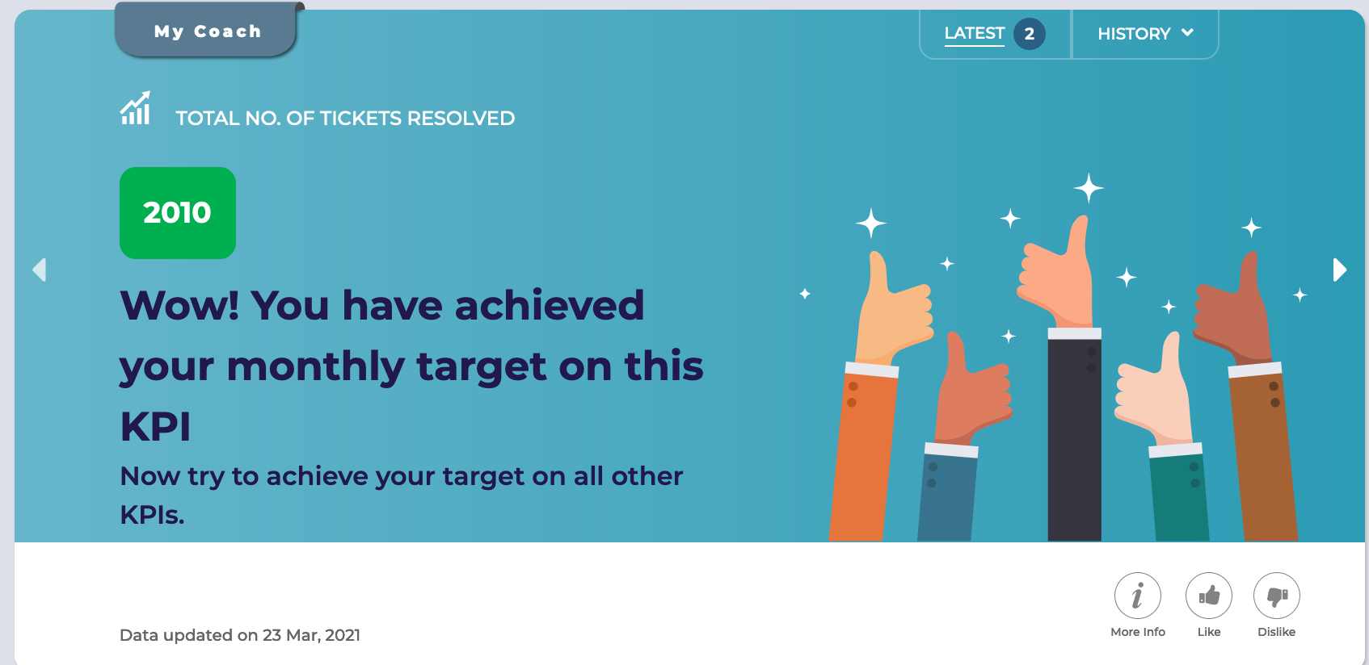
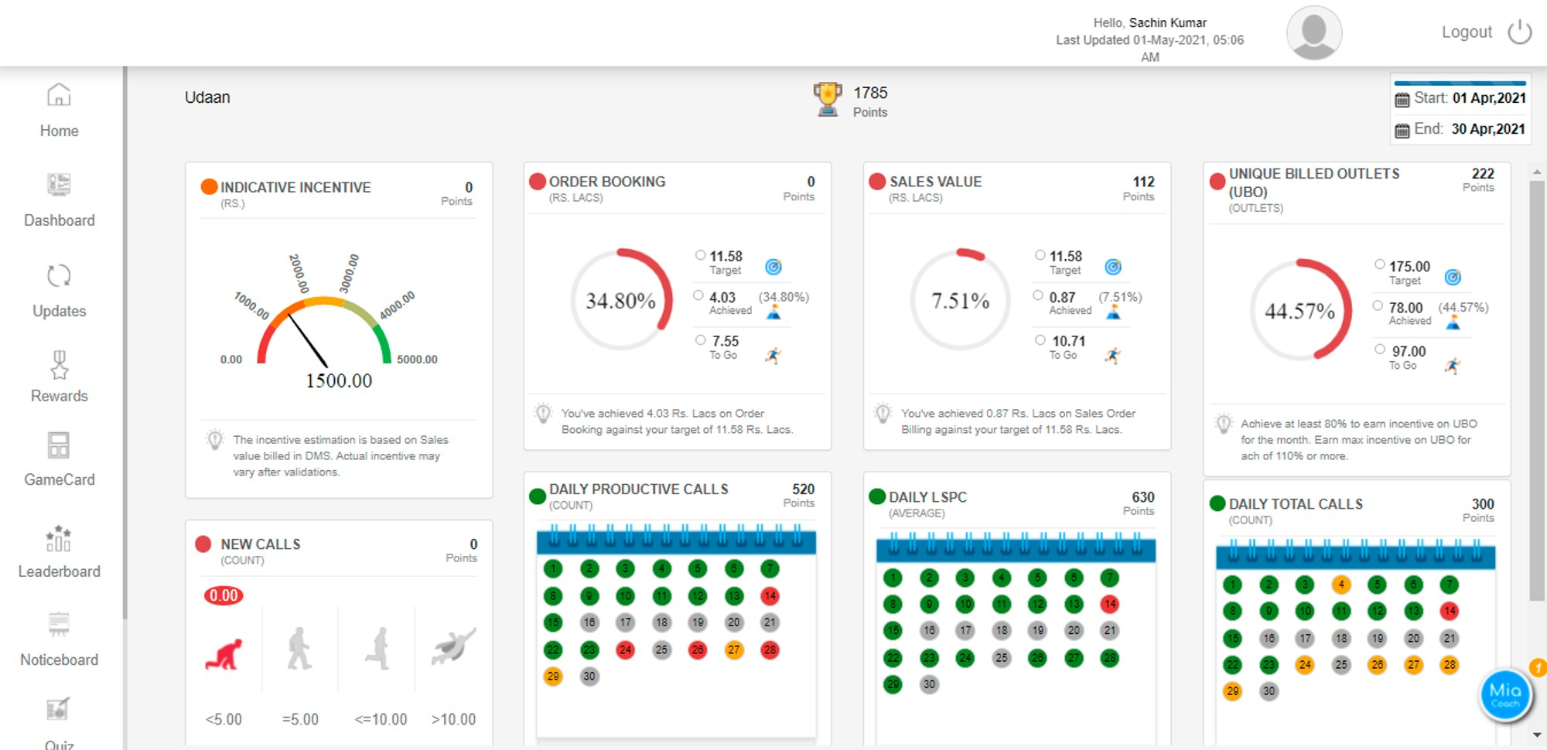
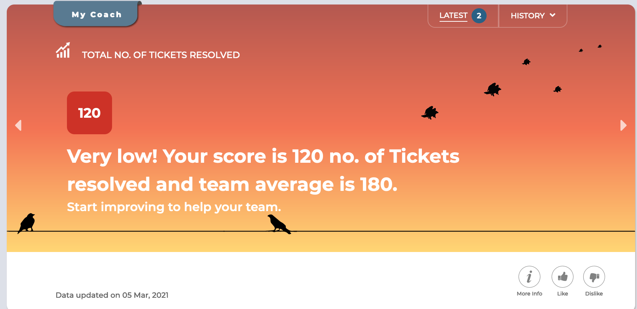
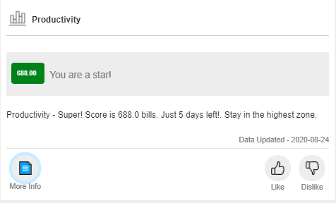
Gamification
Nudges
BPO High Level Presentation

Slide 22
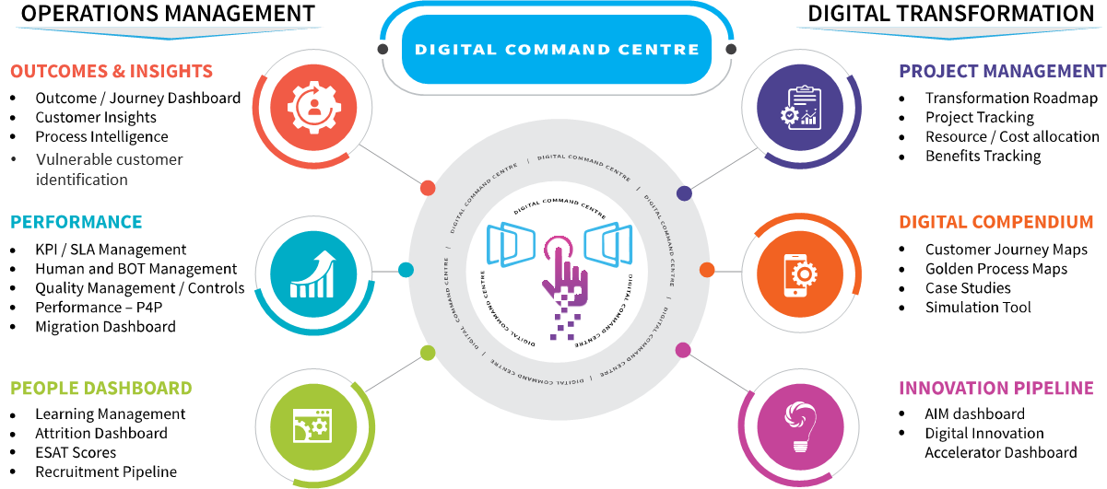
Customer Operations- Digital Command Center
EXL Digital Command Centre (EXL NerveHubTM) allows us to embed Digital Intelligence in Operations and deliver improved outcomes
EXL digital command centre (EXL NervehubTM) solution
A comprehensive enterprise solution that helps manage all aspects of operations
Robust industry-agnostic platform
Links operational metrics with outcomes
Manages digital workforce, and drive customer outcomes through embedded intelligence and real time insights
Unifies data from multiple sources
Provides powerful representation across KPIs (workforce, quality, process, customer journeys etc.)
Digital command centre
10-15%
Reduction in Failure demand (repeat cases, complaints)
8-10%
Improvement in Employee Productivity
3-5%
Improvement in NPS
20-30%
Reduction in cost of operations
10-12%
Improvement in Service Levels
Outcome

Slide 23
EXL Print to Web Datahub solution (SWM 2.0* )
Current State
Target Operating Model (TOM)
Broken view to products at different stages
Centralized Reporting & Work Allocation
Conversion Approach
Unified view to track progress for planned Publish
@3 K - Reprographics
@5 K- Imagery
@8 K- Attribution
@12- Testing
Example
Enable Data ingestion from different systems to the tool leveraging Automation
Data Hub for tracking Volumes in different stages of Print to Web lifecycle
Automated Workflow & Allocation
1
Design Workflow and establish controls across the lifecycle
+
Automate Work Allocation to various teams
2
30 Apr – 10K items ready for Publish
4 May – 15K items ready for Publish
Example
Across Multiple systems
(PM, DAM, GDocs)
Other Key Observations
Manual work Allocation
Weak Control mechanism
Automated Work Allocation
Key Principles of Solution
Data Quality First
Automation
Robust Workflow
*SWM 2.0 is EXL’s proprietary workflow solution

Slide 24
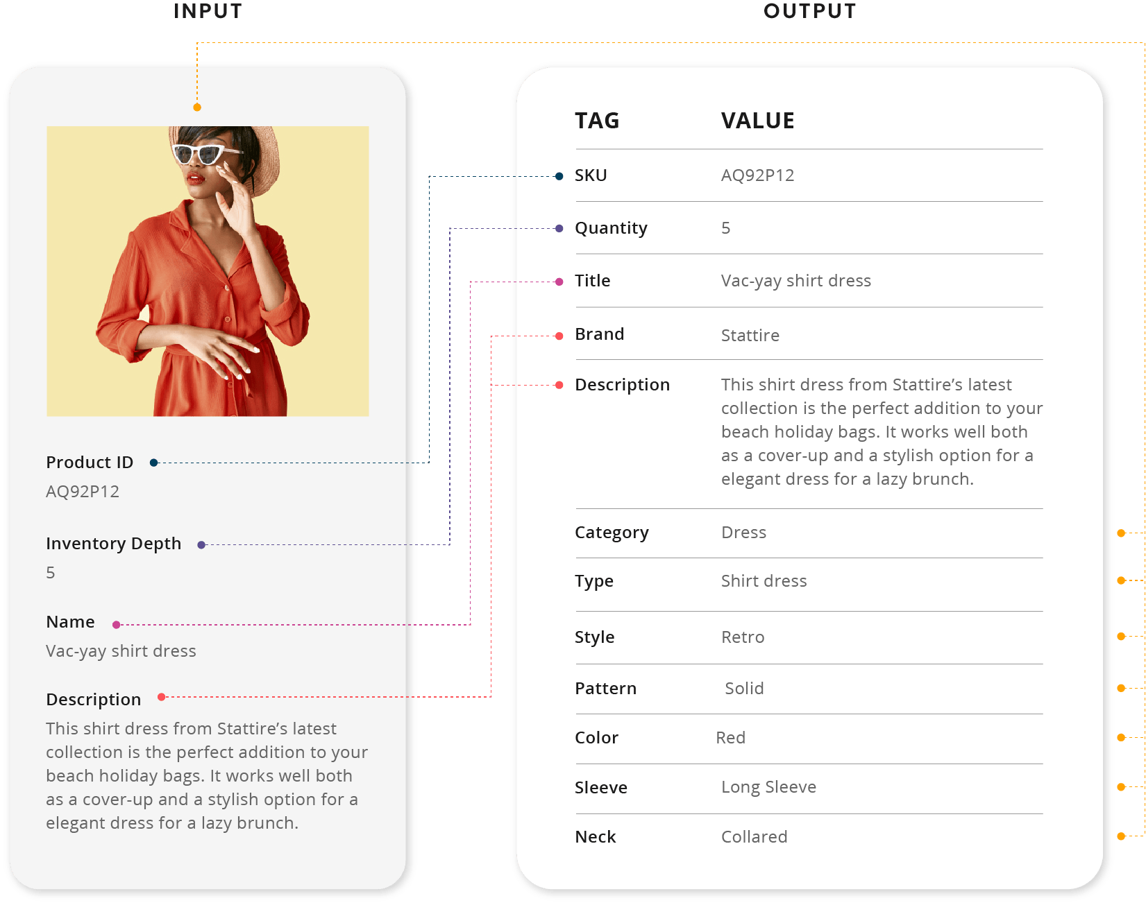
AI led Automated Product Attribution / Tagging
EXL Vue.ai’s tagging solution automatically extracts and creates comprehensive and accurate tags from images and any unstructured text
Data generated using NLP + Vision
Quality Checks to reconcile data generated using Computer Vision and NLP
Data Generated using Vision
Extract attributes purely from Images (Computer Vision)
Data Generated using NLP
Extract Attributes purely from text metadata (Natural Language Processing)
Data Gaps Filled by Predictions from Historic Data With accuracy of prediction

Slide 25


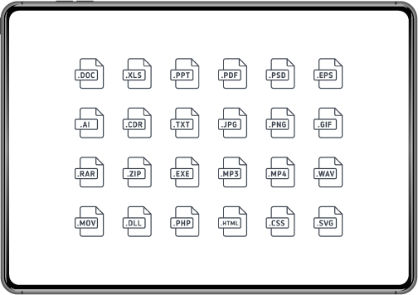

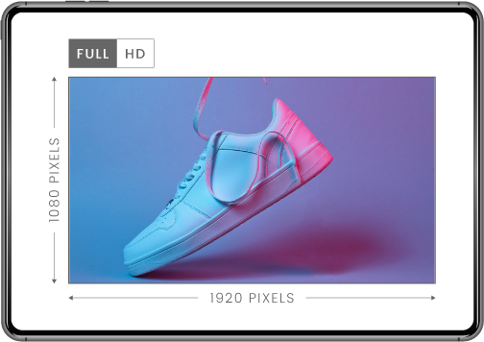


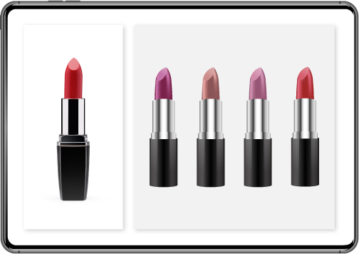
AI led Automated image moderation
With EXL Vue’s image moderation solution automate the assessment of product photos submitted by sellers or users to ensure they match their website guidelines.
Background nature & quality
Blur detection
File format
Presence of frame/border
Image ratio and resolution
Presence of model/mannequins
Text/watermark detection
Multi vs single object
50%
Decrease in personnel requirement
1.3-3X
Reduced time to market
40%
Increase in conversion rate
30%
Increase in unique product views
Outcome

Slide 26

Image Attribute Extraction- Tagging And Mapping Solution Case Study
Background
A globally renowned lifestyle brand, part of one of the biggest European luxury fashion groups - OTB, generating about $ 1B in revenue in 2020 alone.
Business Challenge: New products coming in every season needed to be sorted, styled, photographed, and then sent to the team for attributes to be tagged manually, this resulted in three critical issues: -
Slow onboarding time: More than a week spent waiting for all the images from a shoot to be uploaded before it could be tagged - meaning a longer & delayed go-to-market period.
High time and effort with manual tagging: It took multiple resources over a week to tag & process the images each season
Inconsistency in catalog: The tags & attributes coming in for products from different sources were not standardized.
Opportunity
Moving away from labor intensive processes to data driven & AI/ML led processes
Automate the tagging process, while capable of integrating with their existing PIM tool
Recognize and specifically call out whether certain "iconic" logos are present in the products
Standardize the values and attributes for use across the organization
Streamline the entire process end to end, and save time required for processing
Solution
Automated tagging - Faster product onboarding: Instant tagging was implemented, which can improve catalog processing time by upto 90%.
AI-powered tagging - Scalable process: Granular tagging enriched catalog data which powered filters on the website to assist user journeys, enriched catalogs, and supported analysis and forecasting
Integration: Automated tagging solution via API resulted in seamless and hassle-free tagging of all images
Custom taxonomy for every business: Tool enabled automatic detection of iconic logos on products automatically
How solution works
Benefits
Process product imago, feeds etc.from system
Analyze image & export tags to map through AI
Data can be uploaded to other channels and platform as per required format
18000 images tagged
Downstream effects
PIM and DAM Platform
Deep Machine Learning System processes input
22300 tags generated
Central repository of all the data extracted from images
Continuously re-train the systems & ensure optimal accuracy
Standardized set of tags - ensuring rich & uniform product catalog
eCommerce
Text description
130 batches uploaded
Mapping and Tagging of generated Data in product taxonomy
Price comparison
Website and feeds
90% improved processing time
Product Image
Product data available in the Platform
Marketplaces

Slide 27
DCMS/ SPARC/ COMPASS
Conversion
ETL
One Neutral Schema
Fineos/ Vitech
KEY ADVANTAGES
Feature Gap Analysis
Inventory, Application Reports, Application Partitioning, Job Flow, CICS Flow, Enterprise level Inventory reports
AM Tool Outputs
Policy Master/ Agent Master/ Claim Master Information Layouts
Target Application Gap analysis
Business rule mining, rule repository, Data Model recovery, Data Mapping and Gap analysis for target Data Model, UML export
Accelerated Data Mappings
Data Model
Impact analysis, Automated Code Renovation, Test case generation, Test path Coverage, Slice and Cross reference, Regression testing
DDL Scripts
Testing Automation
Config Rules
Rates, Rules & Data Definitions for Product Configuration
Tool output is used for identifying feature gaps in Fineos / Vitech as well as actual group conversion

Slide 28

Digital CoE for is aimed to streamline end-to-end Print to Web lifecycle leveraging Image AI, Data and Workflow solutions….
Hyperautomation
THE TRADITIONAL AUTOMATION (RPA / RDA) IS NOT ENOUGH
Not applicable on unstructured or semi-structured data
Not applicable on Images
Limited exception handling
Fixes the ‘problem’ not the ‘process’
AI / Machine Learning
Data Transformation
Cloud
Process
Discovery
Workflow
iBPMS
Data & Insights
WITH EXL DIGITAL SUITE
AI infused streamlining of E2E data flows & business processes
Orchestrate multiple technologies to design and deliver E2E business solutions
Automate journeys and experience instead of tasks
Deliver 50-100% higher returns than traditional RPA
Shift from input based commercial models to ROI led models
Automation
(API / RPA / RDA)
Task Automation
Rule-based Decision Making
Structured Inputs
Process Execution
Hyperautomation is “seamless orchestration of multiple technologies such as AI/machine learning, packaged software and automation tools to digitize end to end data flows”
Notes:
SPEAKER NOTES:
EXL’s strategic focus is centered on its strengths in data, analytics, AI and cloud-based operations. These capabilities are designed to create meaningful value for clients at speed:
Advanced analytics solutions combine EXL proprietary and client data with deep domain expertise to enable better and faster decision-making
AI-driven NLP solutions for content and conversation integrate EXL’s industry and process knowledge into best-in-class technology for greater accuracy and speed to deployment
AI-powered operating models orchestrate AI and data upstream on the cloud to leapfrog legacy models and get to market faster
EXL’s enhanced capabilities address a wide range of use cases including AI-powered content extraction in insurance and financial services, behavioral analytics and conversational AI in healthcare, point-of-sale lending in banking, and modernizing workflows across industries with machine learning and cloud.

Slide 29
Rate Card – 100% Work from Office
DIRECT COST
DIRECT COST | Headcount - Annual FTE costs. Year 1 = July 2021 - June 2022 |  |  |  |  |  |  |  |  |  | Annual FTE headcount Years 1-5
 | FTE Headcount *1 | Payroll cost per FTE p.a. (INR) | Any statutory payments / allowances (INR) | Discretionary costs per FTE p.a. (INR) | Bonus payments (INR) | Any other payments (pre-process / attrition / recruitment (INR) | Company overheads (INR) | Net Margin (INR) | Total FTE cost per FTE p.a. (INR) |  | Year | Headcount
Advisors – Admin + Regulated_Email | 110 | 438,520 | 4,241 | 57,127 | 37,851 | 28,764 | 147,689 | 71,386 | 785,577 |  | 1 | 273
Advisors – International | 113 | 579,881 | 4,241 | 57,127 | 49,801 | 53,485 | 185,942 | 58,576 | 989,051 |  | 2 | 425
Advisors – UK | 232 | 493,335 | 4,241 | 57,127 | 45,316 | 56,221 | 184,148 | 139,122 | 979,509 |  | 3 | 364
Advisors | - | - | - | - | - | - | - | - | - |  | 4 | 348
Trainer, QCA, Sr. Executive (WFM) | 8 | 542,965 | 4,247 | 57,118 | 45,842 | 28,608 | 181,110 | 103,463 | 963,353 |  | 5 | 348
Supervisors – AM | 24 | 849,020 | 4,247 | 57,118 | 72,037 | 29,877 | 269,681 | 152,493 | 1,434,473
Managers | 5 | 1,549,163 | 4,247 | 57,118 | 157,172 | 44,633 | 485,412 | 284,235 | 2,581,980
Senior Management | - | - | - | - | - | - | - | - | -
Total (Average per FTE) | 492 | 529,844 | 4,241 | 57,126 | 47,126 | 47,602 | 183,593 | 107,025 | 976,558
WORK FROM OFFICE – FIXED CHARGES
INR per seat | EXL (INR) | EXL (GBP) Per FTE Seat Cost (SU-1.7) | EXL (GBP) Per Seat Cost
Facilities cost | 89,326
IT costs | 118,767
Overheads cost | 55,907
Margin | 33,379
WFH enablement cost
Total Fixed Charge p.a. | 297,379 | £2,887.18 | £4,908.20
Indexation % applied on anniversary | 4.00%
GBP TO INR: 103

Slide 30
Rate Card – 75% WFO + 25% WFH Split
DIRECT COST
DIRECT COST | Headcount - Annual FTE costs. Year 1 = July 2021 - June 2022 |  |  |  |  |  |  |  |  |  | Annual FTE headcount Years 1-5
 | FTE Headcount *1 | Payroll cost per FTE p.a. (INR) | Any statutory payments / allowances (INR) | Discretionary costs per FTE p.a. (INR) | Bonus payments (INR) | Any other payments (pre-process / attrition / recruitment (INR) | Company overheads (INR) | Net Margin (INR) | Total FTE cost per FTE p.a. (INR) |  | Year | Headcount
Advisors – Admin + Regulated_Email | 110 | 438520 | 4241 | 57127 | 37851 | 28764 | 147689 | 71386 | 785577 |  | 1 | 273
Advisors – International | 113 | 579881 | 4241 | 57127 | 49801 | 53485 | 185942 | 58576 | 989051 |  | 2 | 425
Advisors – UK | 232 | 493335 | 4241 | 57127 | 45316 | 56221 | 184148 | 139122 | 979509 |  | 3 | 364
Advisors | - | - | - | - | - | - | - | - | - |  | 4 | 348
Trainer, QCA, Sr. Executive (WFM) | 8 | 542965 | 4247 | 57118 | 45842 | 28608 | 181110 | 103463 | 963353 |  | 5 | 348
Supervisors – AM | 24 | 849020 | 4247 | 57118 | 72037 | 29877 | 269681 | 152493 | 1434473
Managers | 5 | 1549163 | 4247 | 57118 | 157172 | 44633 | 485412 | 284235 | 2581980
Senior Management | - | - | - | - | - |  | - | - | -
Total (Average per FTE) | 492 | 529,844 | 4,241 | 57,126 | 47,126 | 47,602 | 183,593 | 107,025 | 976,558
Akshi & Kushagra to own
WORK FROM OFFICE – FIXED CHARGES
WORK FROM HOME – FIXED CHARGES
INR per seat | EXL (INR) | EXL (GBP) Per FTE Seat Cost (SU-1.7) | EXL (GBP) Per Seat Cost
Facilities cost | 89,326
IT costs | 118,767
Overheads cost | 55,907
Margin | 33,379
WFH enablement cost
Total Fixed Charge p.a. | 297,379 | £2,887.18 | £4,908.20
Indexation % applied on anniversary | 4.00%
INR per seat | EXL (INR) | EXL (GBP) Per FTE Seat Cost (SU-1.0) | EXL (GBP) Per Seat Cost
Facilities cost | 0
IT costs | 171,969
Overheads cost | 46,418
Margin | 28,518
WFH enablement cost
Total Fixed Charge p.a. | 246,905 | £2,397.13 | £2,397.13
Indexation % applied on anniversary | 4.00%
GBP TO INR: 103

Slide 31
Rate Card – 50% WFO + 50% WFH Split
DIRECT COST
DIRECT COST | Headcount - Annual FTE costs. Year 1 = July 2021 - June 2022 |  |  |  |  |  |  |  |  |  | Annual FTE headcount Years 1-5
 | FTE Headcount *1 | Payroll cost per FTE p.a. (INR) | Any statutory payments / allowances (INR) | Discretionary costs per FTE p.a. (INR) | Bonus payments (INR) | Any other payments (pre-process / attrition / recruitment (INR) | Company overheads (INR) | Net Margin (INR) | Total FTE cost per FTE p.a. (INR) |  | Year | Headcount
Advisors – Admin + Regulated_Email | 110 | 438520 | 4241 | 57127 | 37851 | 28764 | 147689 | 71386 | 785577 |  | 1 | 273
Advisors – International | 113 | 579881 | 4241 | 57127 | 49801 | 53485 | 185942 | 58576 | 989051 |  | 2 | 425
Advisors – UK | 232 | 493335 | 4241 | 57127 | 45316 | 56221 | 184148 | 139122 | 979509 |  | 3 | 364
Advisors | - | - | - | - | - | - | - | - | - |  | 4 | 348
Trainer, QCA, Sr. Executive (WFM) | 8 | 542965 | 4247 | 57118 | 45842 | 28608 | 181110 | 103463 | 963353 |  | 5 | 348
Supervisors – AM | 24 | 849020 | 4247 | 57118 | 72037 | 29877 | 269681 | 152493 | 1434473
Managers | 5 | 1549163 | 4247 | 57118 | 157172 | 44633 | 485412 | 284235 | 2581980
Senior Management | - | - | - | - | - |  | - | - | -
Total (Average per FTE) | 492 | 529,844 | 4,241 | 57,126 | 47,126 | 47,602 | 183,593 | 107,025 | 976,558
Akshi & Kushagra to own
WORK FROM OFFICE – FIXED CHARGES
WORK FROM HOME – FIXED CHARGES
INR per seat | EXL (INR) | EXL (GBP) Per FTE Seat Cost (SU-1.7) | EXL (GBP) Per Seat Cost
Facilities cost | 89,326
IT costs | 118,767
Overheads cost | 55,907
Margin | 33,379
WFH enablement cost
Total Fixed Charge p.a. | 297,379 | £2,887.18 | £4,908.20
Indexation % applied on anniversary | 4.00%
INR per seat | EXL (INR) | EXL (GBP) Per FTE Seat Cost (SU-1.0) | EXL (GBP) Per Seat Cost
Facilities cost | 0
IT costs | 171,969
Overheads cost | 46,418
Margin | 28,518
WFH enablement cost
Total Fixed Charge p.a. | 246,905 | £2,397.13 | £2,397.13
Indexation % applied on anniversary | 4.00%
GBP TO INR: 103

Slide 32
Transformation Savings
Summary
LSS | Year 1 | Year2 | Year 3 | Year 4 | Year 5
Headcount savings (cumulative) | 4 | 67 | 128 | 144 | 144
Reduction in charge (£m) | £ 44,604 | £809,041 | £1,663,774 | £1,962,982 | £2,041,501
Total cost (£m) | £7,555 | £345,256 | £563,843 | £554,301 | £641,890
Net benefit - RPA (£m) | £37,049 | £463,785 | £1,099,932 | £1,408,681 | £ 1,399,612
RPA
EXELIA.AI
Piyush, Vikram & Kushagra to own
RPA | Year 1 | Year2 | Year 3 | Year 4 | Year 5
Headcount savings (cumulative) | 2 | 25 | 32 | 32 | 32
Reduction in charge (£m) | £15,556 | £260,854 | £357,053 | £371,335 | £386,189
Cost (one time) (£m)
Cost (Recurring) (£m) | £7,555 | £202,394 | £202,394 | £202,394 | £202,394
Total cost (£m) | £7,555 | £202,394 | £202,394 | £202,394 | £202,394
Net benefit - RPA (£m) | £8,001 | £58,460 | £154,660 | £168,942 | £183,795
Exelia.AI | Year 1 | Year2 | Year 3 | Year 4 | Year 5
Headcount savings (cumulative) | - | 26 | 58 | 68 | 68
Reduction in charge (£m) | - | £327,402 | £764,768 | £942,002 | £979,682
Cost (one time) (£m)
Cost (Recurring) (£m) | - | £92,226 | £260,176 | £322,973 | £425,029
Total cost (£m) | - | £92,226 | £260,176 | £322,973 | £425,029
Net benefit - RPA (£m) | - | £235,176 | £504,592 | £619,029 | £554,653
Lean Six Sigma - Continuous improvement
Customer Journey - Failure Demand Reduction
LSS | Year 1 | Year2 | Year 3 | Year 4 | Year 5
Headcount savings (cumulative) | 2 | 11 | 17 | 23 | 23
Reduction in charge (£m) | £29,047 | £161,450 | £262,581 | £355,598 | £369,822
Total cost (£m)
Net benefit - RPA (£m) | £29,047 | £161,450 | £262,581 | £355,598 | £369,822
LSS | Year 1 | Year2 | Year 3 | Year 4 | Year 5
Headcount savings (cumulative) | - | 5 | 21 | 21 | 21
Reduction in charge (£m) | - | £59,335 | £279,372 | £294,047 | £305,809
Total cost (£m) | - | £50,637 | £101,273 | £28,935 | £14,468
Net benefit - RPA (£m) | - | £8,699 | £178,099 | £265,112 | £291,342
GBP TO INR: 103

Slide 33
Assumptions
EXL solution is on the assumption that resource is available for 2080 hours per annum.
Social distancing cost is not considered in pricing. If there is any social distancing norm, it will be charged additionally.
EXL pricing includes employee’s standard background verification, any additional verification such as specific drug test will be charged at actuals.
Cost of transformation is spread across the deal term. Both parties will mutually agree regarding the recovery of these charges in case there is a significant reduction in the overall scope (threshold for reduction in scope to be agreed)
EXL has made investment of GBP 1.34 MM in migration, transition and ramp cost. If the deal ends before the end period, both parties mutually decide to recover investment made
EXL is proposing a combination of FTE and transaction based pricing model. While the FTE pricing is for work processed by humans, TBP will apply to work carried out by BOTs.
EXL has proposed Pune as the service delivery location
EXL has assumed deal Term as 5 years. COLA @ 4% per annum will be applicable on first contract anniversary.
Quoted rates exclude costs of any BCP component. BCP, if required, will be quoted separately
Pricing does not include any cost for SSAE Type II audits, if required the same will be charged on actual
Prices are exclusive of tax, levy, or similar governmental charge that may be assessed by any jurisdiction, including without limitation, any export, or local VAT, lease tax, sales, use of goods and service tax and excise duty
EXL has assumed SU of 1.7 in pricing. Any changes in SU will lead to change in the rate card provided above.
- We believe that the 1.7 SU is achievable basis the days hours of operations as well as the split between voice and non-voice operation
- We believe there is an opportunity to staff back office operation during lean intervals of the voice/chat operations, allowing for better seat utilization
- It is our understanding that the existing SU ranges between 1.7-1.8 and we have decided to go with 1.7 until we have access to the data which will allow us to calculate, verify and increase our SU beyond 1.7
EXL has factored in 100 kbps per user bandwidth for accessing Next's Citrix / Virtual desktop environment over EXL provisioned MPLS telecom backbone.
EXL will leverage Next's on premise Genesys Contact Center platform (hosted at Next's Leicester Datacentre) for inbound and outbound telephony accessed through EXL provisioned MPLS Telecom backbone.
Next provisioned Genesys Contact Center platform will provide IVR, ACD, inbound & outbound calling, Call recording & retention, Workforce management, Chat and other services as required for the current scope of work.
EXL has factored in 40 kbps per user for accessing Next's Contact Center environment Over EXL provisioned MPLS telecom backbone.
EXL has assumed that Next provisioned softphone agent will be installed (outside citrix / virtual desktop environment) for agent ACD registration and call flow. EXL will provision compatible USB headphones for agents.
GBP to INR: 103
Pricing does not include 22' monitors and Polycom hard phones. These will be charged additionally to NEXT as pass-through
Piyush, Vikram & Kushagra to own

Slide 34
Annexure

Slide 35
Next Success Story- Contact Center
February 2022
October 2021
Step 1
Step 2
Step 3
Step 4
0%
40%
88%
100%
Dealing with a hostile Incumbent & Planning Cut Over
Recruitment Strategy & “Switch Off/On”
Managing the Retail peak & maintaining service levels
Cut Over -“Incumbent free” & Differentiating Ourselves
Targeting the Influencers
Next branding to create Buzz
Leveraging client presence & next brand loyalty
Building pipeline of incumbent candidates
‘One EXL’ Team charter
Resource onboarding strategy for incumbents & new hires
Our people - legal & financial support
100% Work from office whilst maintain distancing
Procuring during global shortage
Data center migration for faster set up
Forecasting volumes & effective WFM
24*7 shift coverage – covering susceptible shifts
Reengineering training timelines
Monitoring abandoned rates & Incumbent trends
Communication with employees
3rd peak and enabling 50% WFH
Motivated workforce
Transformation Agenda Q1’22
Gamification- AI Coach
Smart Audit. AI
Email.AI & Robotics
Automating organizational reporting
Key Highlights
Incumbent & new hires hiring completed
100% support staff on boarded
100% volume owned by EXL
Winning strategy
EXL Volume Ramp

Slide 36
Thank you

